Slide 1
Internship Summary
Lim Jia Wei
Che’er Min Yi

Slide 2
Program assigned - Min Yi
Week | Program
0 | Setup
1 | Data Preprocessing
2 | Supervised Machine Learning Algorithms
3 | Unsupervised Machine Learning Algorithms
4 | Web Scraping
5 | Deep Learning
6 | Linear Algebra and Calculus

Slide 3
Program assigned - Jia Wei
Week | Program
0 | Setup
1 | Introduction to Data Science (DS) and Foundations of Data Science
2 | Statistics for Data Science
3 | Clustering
4 | Hypothesis Testing and Classification
5 | Deep Learning
6 | Recommendations and Ranking
7 | Networking
8 | Graphical Models

Slide 4
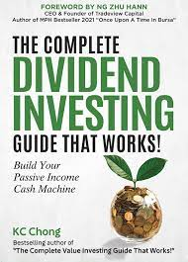
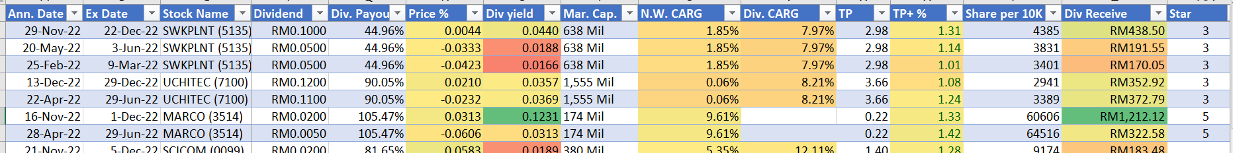
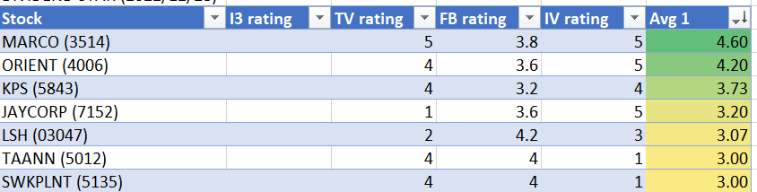
Project assigned - Dividend Investing
Build a dashboard to present and analyze financial metrics to identify stocks that would be good investments for dividends
Create a model to forecast the future dividend performance of a stock

Slide 5
Project Schedule
Step 1 | Get stock code and stock name - (2 days)
Step 2 | Get historical stock price - (5 days)
Step 3 | Obtain latest stock price - (3 days)
Step 4 | Get financial metrics (KLSE and Bursa Malaysia) - (6 days)
Step 5 | Perform data cleaning/formatting and joining (ETL) - (10 days)
Step 6 | Stored it into database - (3 days)
Step 7 | Build a dashboard in Power BI - (3 days)
Step 8 | Build predictive model - (4 days)

Slide 6
Architecture of the project
External Source
Data Processing
Visualization
Bursa (Stock Code, Stock Name, Financial Metrics)
Database (dividendinvesting)
div_info
ETL
daily_stock
div_perf
stock_perf
Yahoo Finance (Share Price - Historical/Latest Data)
stock_info
final_summary
PowerBI
(Dashboard)
latest_sum
KLSE (Financial Metrics)
Modeling
(Boosted Tree, pycaret)

Slide 7
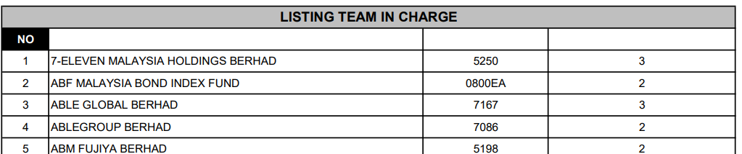
Web scraping stock code and stock name
Download “List_of_Companies_2022.06.24__Website_.pdf” from Bursa Malaysia
Read the PDF file and scrape tables using python library “tabula”
Combine stock code and stock name into a dataframe
Remove duplicate stock and delisted stock
* The above image is an example of tables found in the 'List_of_Companies_2022.06.24__Website_.pdf' file, which contains the stock code and stock name.

Slide 8
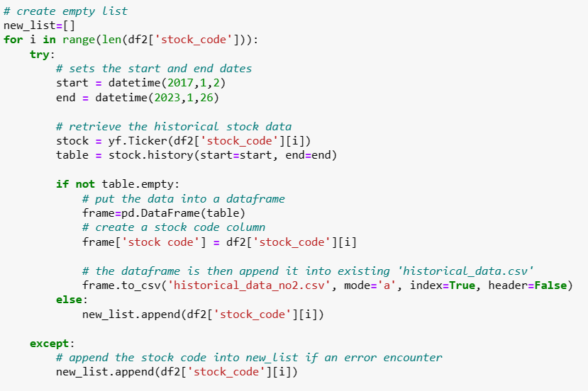
Web scraping historical stock data
Scrape historical stock data from 2017 to 2023 using the Python library 'yfinance'
One time scrapping
Problem :
Not all the historical stock data can be scrape one time, and an error may be encountered
Solution:
Save the stock code in a list , run a second loop

Slide 9
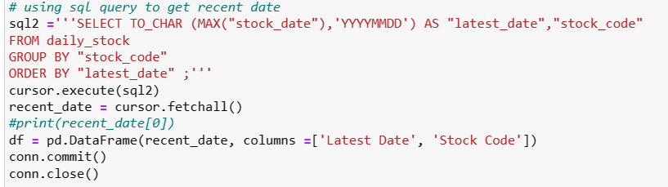
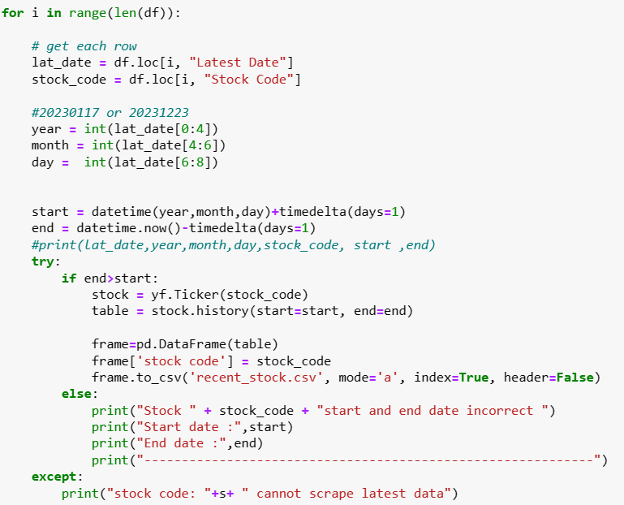
Web scraping latest stock data
Scrape daily stock data using the Python library “yfinance”
Use sql query to get the latest date for each stock
Scrape the stock data starting from the day after latest date
Scrape daily

Slide 10
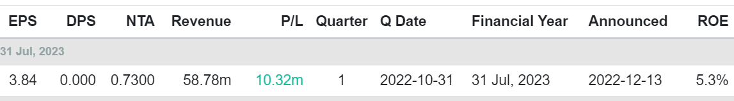
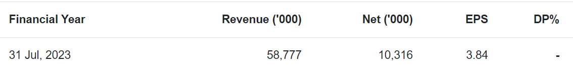
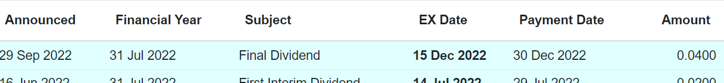
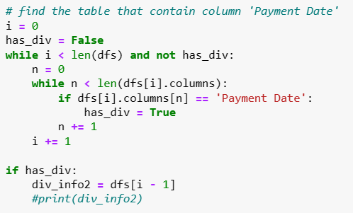
Web scraping financial metrics
Scrape dividend, quarter and annual tables from KLSE to extract financial metrics
Problem:
Tables may not be in the same order
Solution:
Find the unique columns of each table
Quarter reports table from KLSE
Annual reports table from KLSE
Dividend table from KLSE

Slide 11
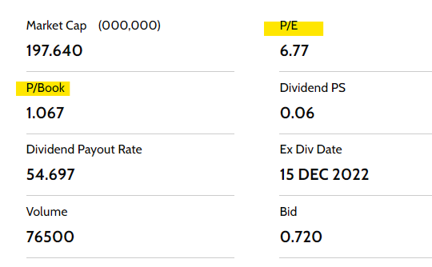
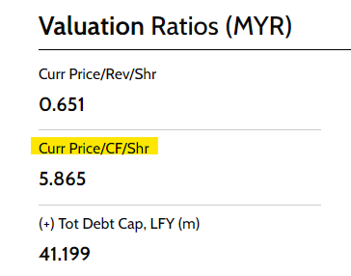

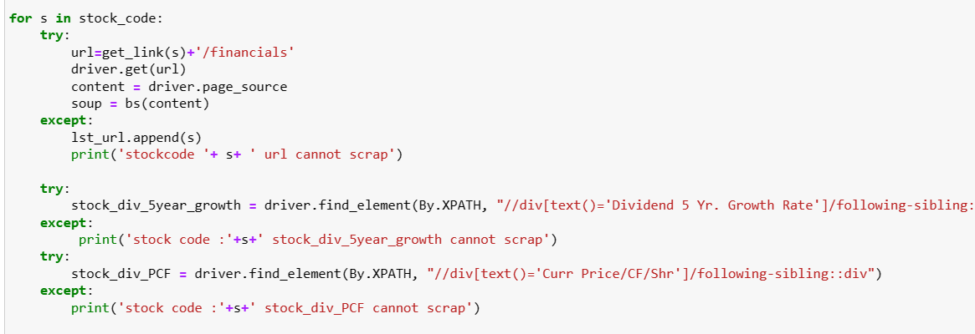
Web scraping financial metrics
Scrape financial metrics that are updated daily and are only available on Bursa Malaysia
Problem:
Error may occurs in different financial metric for each stock code
Solution :
Use try and except for each financial metrics
Update the correct value manually

Slide 12
Definition of financial metrics
Financial Metrics | Definitions
Dividend Yield (DY) | Annual dividend per share/Current Share price
Dividend Payout Ratio (DPR) | Annual dividend/Net income attributed to common shareholders
Earning per share (EPS) | Net income of the company/Average outstanding share of the company
Return on equity (ROE) | Annual net income/Shareholders equity
Price to book value (PB) | Market price per share/Book value per share
Price to earning ratio (PE) | Stock’s current price/Latest EPS
Price to cash flow (P/CF) | Market capitalization/Cash flow from operations
Growth rate (GR) | (Latest Dividend/Initial Dividend)^1/n - 1, where n is the period

Slide 13
Scoring for all the financial metrics
Financial Metrics | Scoring
 | 1 | 2 | 3 | 4 | 5
DY | < 1 | 1 ≤ x ≤ 3 | 3 ≤ x ≤ 6 | 6 ≤ x ≤ 10 | > 10
DPR | < 10 or > 90 | 70 < x ≤ 90 | 10 ≤ x < 20 | 50 < x ≤ 70 | 20 ≤ x ≤ 50
EPS | < 20 | 20 ≤ x < 40 | 40 ≤ x < 60 | 60 ≤ x < 90 | ≥ 80
ROE | < 20 | 20 ≤ x < 50 | 50 ≤ x < 70 | 70 ≤ x < 100 | ≥ 100
PB | > 2.5 | 1.5 < x ≤ 2.5 | 1 < x ≤ 1.5 | 0.5 < x ≤ 1 | 0 ≤ x ≤ 0.5
PE | > 70 | 50 < x ≤ 70 | 25 < x ≤ 50 | 20 ≤ x ≤ 25 | < 20
P/CF | >100 | 20 < x ≤ 100 | 10 < x ≤ 20 or > 0 | 0.75 < x ≤ 10 | 0 ≤ X ≤ 0.75
GR | ≤ -25 | -25 < x ≤ 0 | 0 < x ≤ 25 | 25 < x ≤ 50 | > 50

Slide 14
Predict the top 10 stock using models
Models | 2022 Top 10 | Predicted Top 10
Boosted Tree | 5168 1163 5012 7106 1082 1929 4006 5139 6009 8044 | 8044 - 16 3255 - 14 1929 - 13 5139 - 13 2837 - 13 5168 - 13 4006 - 13 9059 - 13 7106 - 13 5819 - 12 30% accuracy
Pycaret (Catboost) |  | 8044 - 16 5168 - 14 1929 - 14 5139 - 14 3255 - 13 5012 - 13 2836 - 13 5819 - 13 5254 - 13 7106 - 12 50% accuracy
Using data from 2018 - 2021 as training data and test data, 2022 data used to predict the score
Predictor Variables: DY, DPR, EPS, ROE
Response Variable: Overall score

